Slide 1
Incomplete Christianity
Hebrews 5:11-14

Slide 2
Evaluate your Hearing

Slide 3
1 Corinthians 3:1-3
But I, brothers, could not address you as spiritual people, but as people of the flesh, as infants in Christ. I fed you with milk, not solid food, for you were not ready for it. And even now you are not yet ready, for you are still of the flesh.

Slide 4
Evaluate your Hearing

Slide 6
Train for Maturity

Slide 7
Ephesians 4:11-16
11 And he gave the apostles, the prophets, the evangelists, the pastors and teachers,
12 to equip the saints for the work of ministry, for building up the body of Christ,
13 until we all attain to the unity of the faith and of the knowledge of the Son of God, to mature manhood, to the measure of the stature of the fullness of Christ,
14 so that we may no longer be children, tossed to and fro by the waves and carried about by every wind of doctrine, by human cunning, by craftiness in deceitful schemes.
15 Rather, speaking the truth in love, we are to grow up in every way into him who is the head, into Christ,
16 from whom the whole body, joined and held together by every joint with which it is equipped, when each part is working properly, makes the body grow so that it builds itself up in love.

Slide 8
Ephesians 4:25-32
25 Therefore, having put away falsehood, let each one of you speak the truth with his neighbor, for we are members one of another.
26 Be angry and do not sin; do not let the sun go down on your anger,
27 and give no opportunity to the devil.
28 Let the thief no longer steal, but rather let him labor, doing honest work with his own hands, so that he may have something to share with anyone in need.
29 Let no corrupting talk come out of your mouths, but only such as is good for building up, as fits the occasion, that it may give grace to those who hear.
CONTINUED

Slide 9
Ephesians 4:25-32
30 And do not grieve the Holy Spirit of God, by whom you were sealed for the day of redemption.
31 Let all bitterness and wrath and anger and clamor and slander be put away from you, along with all malice.
32 Be kind to one another, tenderhearted, forgiving one another, as God in Christ forgave you.

Slide 10
Strive to Teach Others

Slide 11
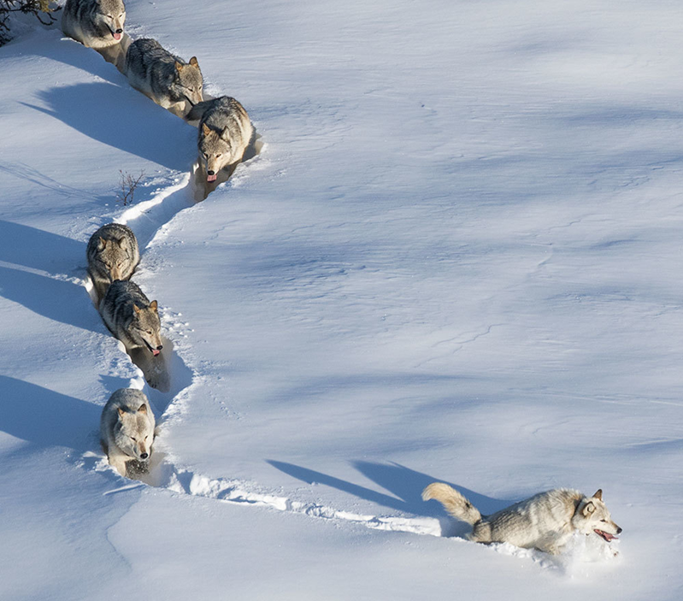
https://www.instagram.com/p/B8VovLjHOfR/

Slide 12
Hebrews 5:12
12 In fact, though by this time you ought to be teachers, you need someone to teach you the elementary truths of God’s word all over again. You need milk, not solid food!
https://www.instagram.com/p/B8VovLjHOfR/

Slide 13
Hebrews 5:12
12 In fact, though by this time you ought to be teachers, you need someone to teach you the elementary truths of God’s word all over again. You need milk, not solid food!
https://www.instagram.com/p/B8VovLjHOfR/

Slide 15
You Cannot Be Lazy in Your Obedience to God and Expect to Grow Closer to Him

Slide 17
But grow in the grace and knowledge of our Lord and Savior Jesus Christ 2 Peter 3:18

Slide 18
2 Reasons to Grow in Christ 1. So that YOU Don’t Drift Away

Slide 19
2 Reasons to Grow in Christ 1. So that You Don’t Drift Away 2. So that You Can Pass It On

Slide 20
If You Are Not Passing On Your Faith In Christ, You are Practicing an Incomplete Christianity

Slide 21
It’s Time To Start Eating Solid Food!

